Slide 1
CS2115 Computer Organization 2023/2024 Sem A
Chapter 8: Multicore & GPU
Dr. Nan Guan
Department of Computer Science
City University of Hong Kong

Slide 2
Sequential Execution
Fetch
Decode
Execute
Memory
Writeback
Address
IR
Instruction
NextPC
Data
Data
Address
Sel
Sel
Imm
Imm
Main Memory
Decoder
Add
Sel
Sel
Operands
Register
Files
Mul
Reg.
Data
. . .
Data
ALU
Data

Slide 3
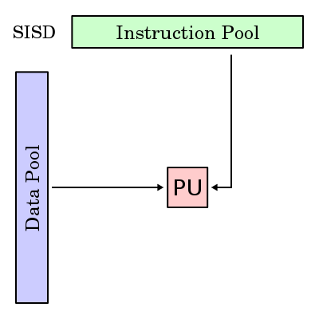
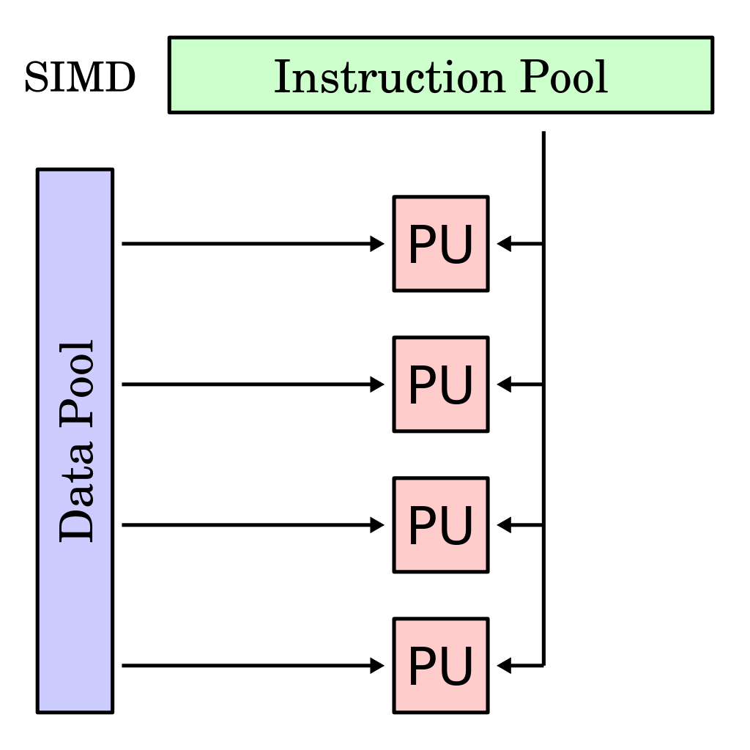
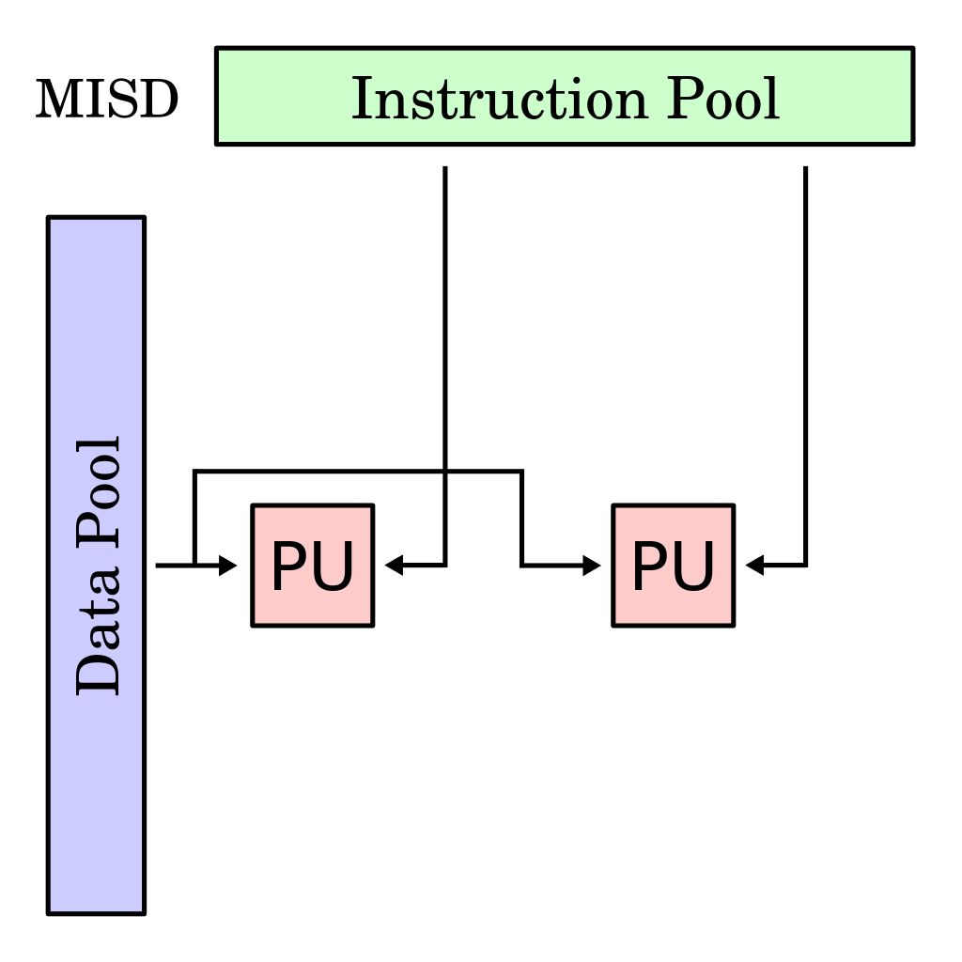
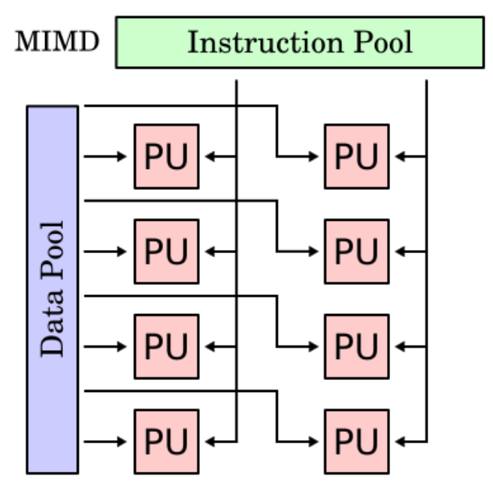
Processing Models
single instruction and single data (SISD)
single instruction and multiple data (SIMD)
multiple instruction and single data (MISD)
multiple instruction and multiple data (MIMD)
Notes:
The concepts we just talked about is highly simplified. Actually if we look into the There are four types of architectures of the processors.
starting with SISD, single instruction and single data stream. we have instructions are taken from a single instruction stream and then these instructions are operated on single data stream. The example processors are computers belong to these class of computer architecture are uniprocessor system.
The next class of computer architecture is SIMD, single instruction and multiple data. Here, we have instruction from a single instruction stream, but these instructions are operated on multiple data streams. Effectively, we can exploit the parallelism available at the data level, in the sense that if we need to do the same operation . And the example systems that belong to this class of computer architecture are vector architectures, array processors, GPUs, multimedia extensions and so on.
The third class of computer architecture is MISD, multiple instructions and single data stream, but actually this class of computer architecture is defined just for the completeness sake, but there is no commercially viable implementation of systems belonging to this particular class.
And the last class of computer architecture is MIMD, multiple instructions and multiple data. Here instructions are taken from multiple instruction streams and these can be operated on multiple data streams simultaneously. So, effectively we can exploit parallelism available at thread level. And example systems that belong to this class of computer architecture are multicore processors.
In this course, we will mainly focus on the first type SISD -- basic, fundamental, important
Will also briefly talk about the SIMD and MIMD later

Slide 4
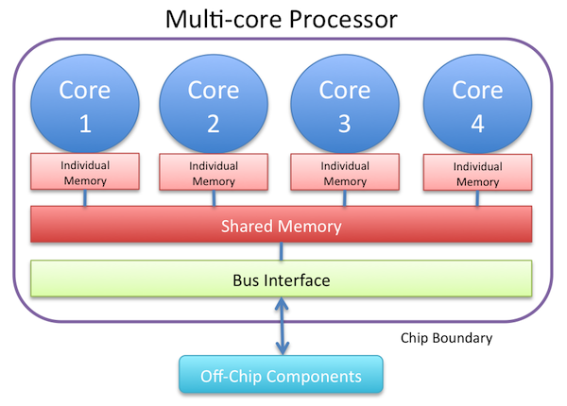
Multicore Processors
A single chip with two or more separate processing units (cores)
Each of which reads and executes program instructions
Increasing overall speed for programs that support multithreading or other parallel computing techniques
Which processing model?
(among the four in the previous page)

Slide 5
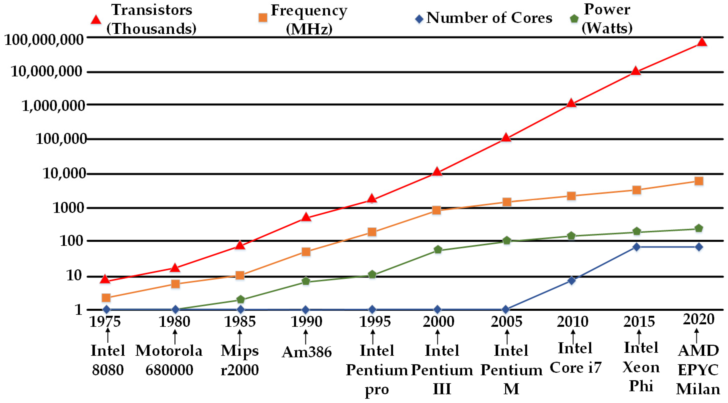
Trend of Morden Processors
Moore’s Law:
integrated circuit resources double every 18–24 months
Notes:
Now let have a look the trends of modern processors regarding several aspects we have mentioned
Redline is the number of transistors integrated on the processor chip.
Increase exponentially, note this is not linear increase, it is exponential if we look at the y-axis
This trend is usually called the Moore’s law
Moore’s Law resulted from a 1965 prediction of such growth in IC capacity made by Gordon Moore, one of the founders of Intel
Surprisingly, this prediction is very accurate,
Some very important principles in computer design
As computer designs can take years, the resources available per chip can easily double or quadruple during the project. Computer architects must anticipate where the technology will be when the design finishes rather than when it starts
Yellow line is the frequency or the speed of the processor
Until 2000 or so, when I studied in the university, it roughly increase the same as transistors
Every 1.5 or 2 years, the frequency becomes twice as fast
After 2000, the increase slow down, still increase, but much slower
As we introduced, the power of computer heavily correlates with the frequency
As the frequency growth slow down, the
When frequency not increasing as fast as before, performance mainly come from integrating more cores on the processor
Since 2005, start to multi-core processors on desktop computers
Grow very fast until 2015
Why is that?

Slide 6
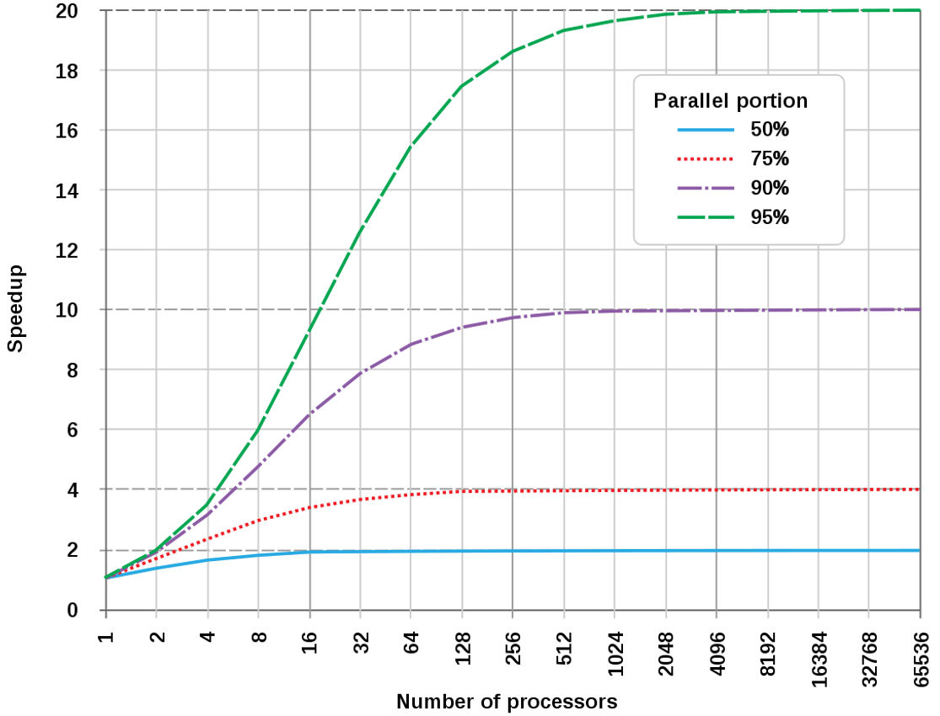
Amdahl’s Law
In a program with parallel processing , a few instructions that have to be performed in sequence will have a limiting factor on program speedup such that adding more processors may not make the program run faster.

Slide 7
Amdahl’s Law
ExeTime^{old}
Speedup =
ExeTime^{new}
ExeTime^{old}: execution time of entire task without enhancement
ExeTime^{new}: execution time of entire task with enhancement
Fraction_{enhanced}
ExeTime_{new} = ExeTime_{old} × [(1 - Fraction_{enhanced}) + ]
Speedup_{enhanced}
ExeTime^{old}
1
Speedup = =
ExeTime^{new}
Fraction_{enhanced}
(1 - Fraction_{enhanced}) +
Speedup_{enhanced}
Notes:
Is a formula which gives the theoretical estimation about how fast you can speedup the computation of some tasks by providing extra processing resource
Before describing what is Amdahl’s law, let us define “Speedup”.
“Speedup” is the ratio between Exetime old, which represents the “The execution time of an entire task using an enhancement applied when possible” and Exetime new, which represents the “The execution time of an entire task without using an enhancement”
Let us think we have an enhancement that we want to apply on a piece of code. When I apply, what is the performance I am going to get and without applying that what is the performance I am going to get? and when I take the ratio of this then what I am going to get “Speedup”.
That shows that, we will get this much Speedup when I apply this particular enhancement on the piece of code.
Now, having defined the speedup, let us look at the Amdahl’s law.Amdahl’s law states that performance improvement to be gained from using some enhancement is limited by the fraction of the time the enhancement can be used.
These are two different things: “The performance improvement to be gained by using some enhancement” and the second one is “The fraction of time the enhancement can be applied”.
If the fraction of time the enhancement applied if 0, then you are not going to gain any performance improvement. On the other hand, for the complete execution of the time if the enhancement is applied then you will get a significant improvement in the performance.
To be more precise, let refine the formula defining speedup to see what is the effect exactly.
[show formula]

Slide 8
Amdahl’s Law
When executing software on multi-core processors, the ideal speedup achieved is equal to the number of processor cores (or called cores for short)
In reality, only part of the software can be parallelized
Example: suppose 80% of a software program can be parallelized, what is the best speedup if it is executed on 100 processor cores?
ExeTime^{old}
1
1
Speedup = =
=
= 1/0.208 = 4.808
ExeTime^{new}
Fraction_{enhanced}
(1-0.8) + 0.8/100
(1 - Fraction_{enhanced}) +
Speedup_{enhanced}
Notes:
Come back to the early question that why don’t we simply putting more cores on the processor to increase performance
When executing software on multi-core processors, the ideal speedup achieved is equal to the number of processor cores (or called cores for short)
In reality, only part of the software can be parallelized
Typical behaviour:

Slide 9
Exercise 1
80% of a program can be perfectly parallelized; 10% can be parallelized on at most 4 cores; the remaining has to execute sequentially
What is the speedup if executed on 8 cores?
Notes:
Exe_old = x
Exe_new = 0.8 x * 1/8 + 0.1x * ¼ + 0.1 x = 0.225x
X / 0.225x = 4.44

Slide 10
Exercise 2
40% of a program can be perfectly parallelized; 40% can be parallelized on at most 8 cores; 10% can be parallelized on at most 4 cores; the remaining has to execute sequentially
To achieve speedup of 4, how many cores are needed at least?
To achieve speedup of 8, how many cores are needed at least?
Notes:
(1)
exe_old = x, speedup = 4, so exe_new = 0.25x
Exe_new = 0.4 x / y + 0.5x / 4 + 0.1 x = 0.25x
y =16
(2)
exe_old = x, speedup = 8, so exe_new = 0.125x
Exe_new = 0.4 x / y + 0.4 x / 8 + 0.1 x / 4 + 0.1x = 0.125x
Impossible to obtain a positive y

Slide 11

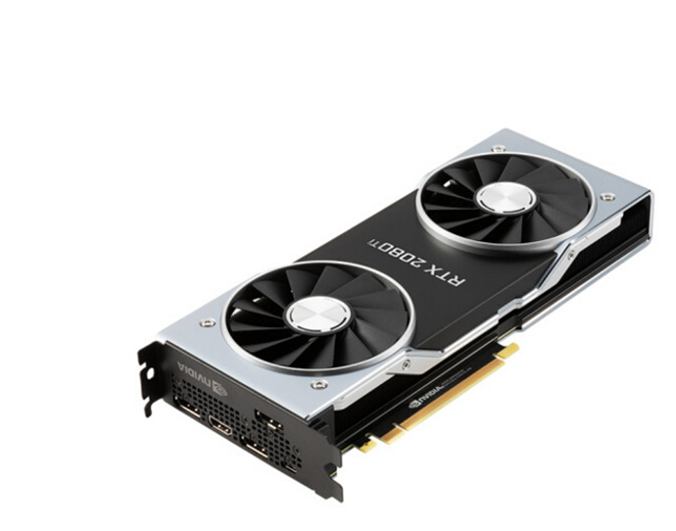


GPU (Graphic Processing Unit)

Slide 12
Graphics Applications
Graphics pipeline have a lot of redundant instructions
Draw dots
Draw triangles
Draw lines
Raster an image(convert from vector to pixel bitmap)
Draw surfaces
Determine which object to be shown on each pixel
Compute lightning on each pixel
Repeat
All of these are lots of adding and multiplying tons of independent data in parallel !

Slide 13
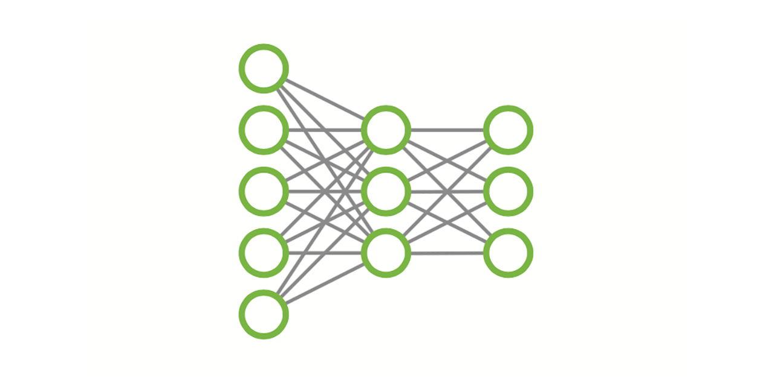

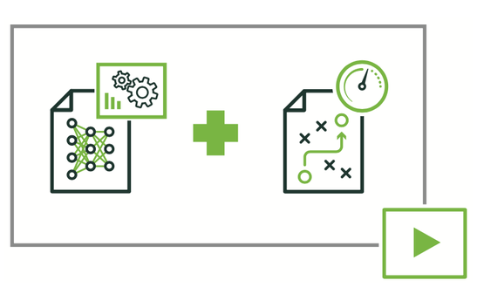
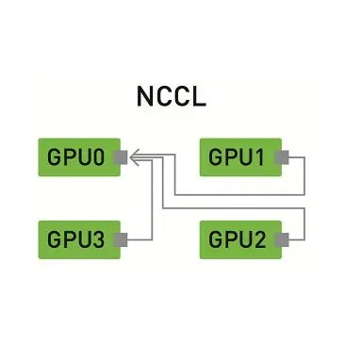

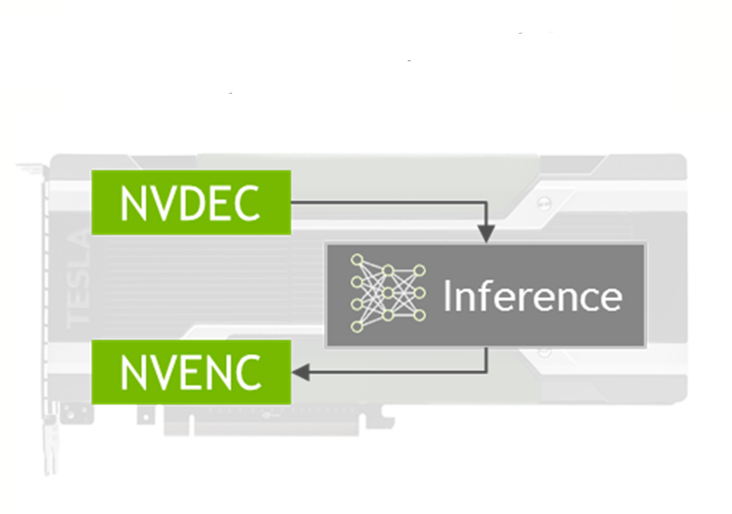

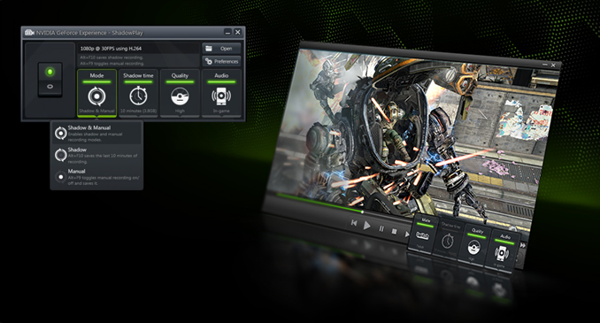
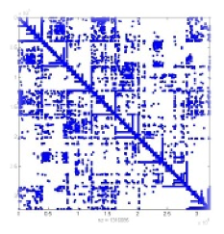

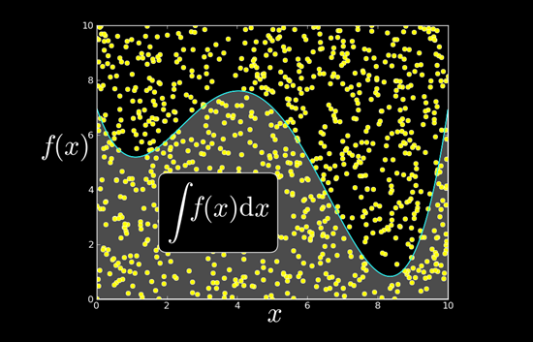
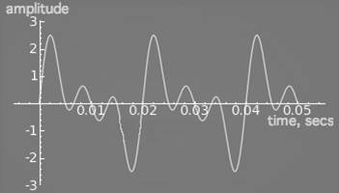



GPU in Modern Systems
cuDNN
nvGRAPH
TensorRT
NCCL
DOMAIN-SPECIFIC
NVIDA NPP
DeepStream SDK
NVIDIA CODEC SDK
Index Framework
VISUAL
PROCESSING
LINEAR
ALGEBRA
cuSPARSE
cuBLAS
cuRAND
cuFFT
MATH
ALGORITHMS
CUDA Math library
AmgX
cuSOLVER
THRUST LIBRARY

Slide 14
GPU: SIMD
Idea: Use one decoder on multiple data
Basically all these data perform the same operation
Save logic required to fetch/decode tons of instructions
SIMD: Single-instruction multiple-data

Slide 15
GPU Architecture
SM
SP: Scalar Processor
‘CUDA core’
Executes one ‘thread’
SP
SP
SP
SP
SP
SP
SP
SP
SP
SP
SP
SP
SP
SP
SP
SP
SM: Streaming Multiprocessor
multiple SPs (16, 32, 48 or more)
Fast local ‘shared memory’
shared among SPs
e.g., 16 KB or 64 KB
SHARED MEMORY
GLOBAL MEMORY
(ON DEVICE)
In this lecture, we use NVIDIA GPU as the example
HOST (CPU)

Slide 16
GPU Architecture
SM
SP
SP
SP
SP
For example, GTX 480:
14 SMs x 32 SPs = 448 cores on a GPU
SP
SP
SP
SP
SP
SP
SP
SP
SP
SP
SP
SP
SHARED MEMORY
GDDR memory
512 MB - 6 GB
GLOBAL MEMORY
(ON DEVICE)
HOST

Slide 17
GPU Programming Models
CUDA (Compute Unified Device Architecture): parallel GPU programming API created by NVIDIA
Hardware and software architecture for issuing and managing computations on GPU
API libraries with C/C++/Fortran language
Other models (not covered in this course):
OpenGL – an open standard for GPU programming
DirectX – a series of Microsoft multimedia programming interfaces

Slide 18
CUDA Structure
Kernel: a function executed on the GPU
Thread: a minimum unit managed by CUDA runtime
Threads execute the same copy of codes
Warp: a scheduling unit of up to 32 threads
Block: a user-defined group of threads (usually multiple of 32)
Grid: a group of one or more blocks.
A grid is created for each CUDA kernel
Host
Device
Grid 1
Kernel 1
Block
(0, 0)
Block
(1, 0)
Block
(2, 0)
Block
(0, 1)
Block
(1, 1)
Block
(2, 1)
Grid 2
Kernel 2
Block (1, 1)
Thread
(0, 0)
Thread
(1, 0)
Thread
(2, 0)
Thread
(3, 0)
Thread
(4, 0)
Thread
(0, 1)
Thread
(1, 1)
Thread
(2, 1)
Thread
(3, 1)
Thread
(4, 1)
Thread
(0, 2)
Thread
(1, 2)
Thread
(2, 2)
Thread
(3, 2)
Thread
(4, 2)

Slide 19
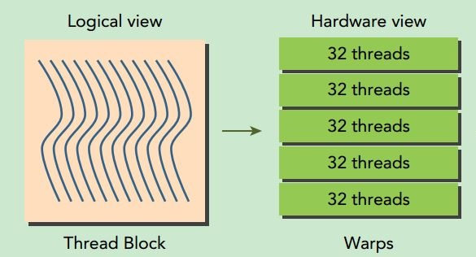
CUDA Structure
One block executes on one SM
All threads sharing the shared memory
Blocks execute on SMs in parallel independently
E.g., 128, 192, or 256 threads in a block
A thread executes on one SP at a time
But may execute on different SP at different time
Warp: a scheduling unit of up to 32 threads
Each block is physically executed by multiple warps
Host
Device
Grid 1
Kernel 1
Block
(0, 0)
Block
(1, 0)
Block
(2, 0)
Block
(0, 1)
Block
(1, 1)
Block
(2, 1)
Grid 2
Kernel 2
Block (1, 1)
Thread
(0, 0)
Thread
(1, 0)
Thread
(2, 0)
Thread
(3, 0)
Thread
(4, 0)
Thread
(0, 1)
Thread
(1, 1)
Thread
(2, 1)
Thread
(3, 1)
Thread
(4, 1)
Thread
(0, 2)
Thread
(1, 2)
Thread
(2, 2)
Thread
(3, 2)
Thread
(4, 2)

Slide 20
CUDA Structure
Each block has a unique ID
blockIdx: identifier for a block (1D, 2D or 3D)
E.g., (blockIdx.x, blockIdx.y, blockIdx.z)
blockDim: the size of the block
Each thread has a unique ID within a block
threadIdx: identifier for a thread (1D, 2D or 3D)
E.g., (threadIdx.x, threadIdx.y, threadIdx.z)
Host
Device
Grid 1
Kernel 1
Block
(0, 0)
Block
(1, 0)
Block
(2, 0)
Block
(0, 1)
Block
(1, 1)
Block
(2, 1)
Grid 2
Kernel 2
Block (1, 1)
Thread
(0, 0)
Thread
(1, 0)
Thread
(2, 0)
Thread
(3, 0)
Thread
(4, 0)
Thread
(0, 1)
Thread
(1, 1)
Thread
(2, 1)
Thread
(3, 1)
Thread
(4, 1)
Thread
(0, 2)
Thread
(1, 2)
Thread
(2, 2)
Thread
(3, 2)
Thread
(4, 2)

Slide 21
CUDA Structure
Build-in variables:
In this example
gridDim.x=3, gridDim.y =2
blockDim.x=5, blockDim.y=3
blockIdx.x = 1, blockIdx.y = 1
threadIdx.x = 2, threadIdx.y = 1
Host
Device
Grid 1
Kernel 1
Block
(0, 0)
Block
(1, 0)
Block
(2, 0)
Block
(0, 1)
Block
(1, 1)
Block
(2, 1)
Grid 2
Kernel 2
Block (1, 1)
Thread
(0, 0)
Thread
(1, 0)
Thread
(2, 0)
Thread
(3, 0)
Thread
(4, 0)
Thread
(0, 1)
Thread
(1, 1)
Thread
(2, 1)
Thread
(3, 1)
Thread
(4, 1)
Thread
(0, 2)
Thread
(1, 2)
Thread
(2, 2)
Thread
(3, 2)
Thread
(4, 2)

Slide 22
CUDA: Programming
Declarations on functions: __host__, __global__, __device__
__host__ indicates host functions which execute on CPU
__global__ makes a function for a kernel which executes on GPU
__device__ indicates device functions, which can only be called from other device or global functions. It cannot be called from host code
Launch kernel: mapping of thread programs to device
kernel <<<grid_size, block_size>>>(<args>)

Slide 23
CUDA: Programming
mycode.cu
Compiled by CPU
compiler
Compiled by GPU
compiler
int main_data;
__shared__ int sdata;
int main_data;
__shared__ sdata;
Main() { }
__host__ hfunc () {
int hdata;
gfunc<<<g,b,m>>>();
}
Host Only
Main() {}
__host__ hfunc () {
int hdata;
gfunc<<<g,b,m>>>();
}
__global__ gfunc() {
int gdata;
dfunc()
}
__global__ gfunc() {
int gdata;
dfunc();
}
Interface
__device__ dfunc() {
int ddata;
}
Device Only
__device__ dfunc() {
int ddata;
}

Slide 24
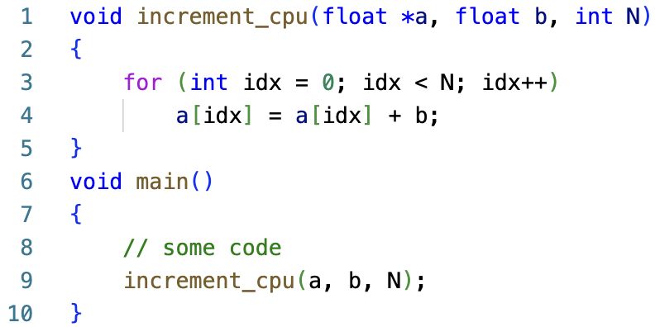
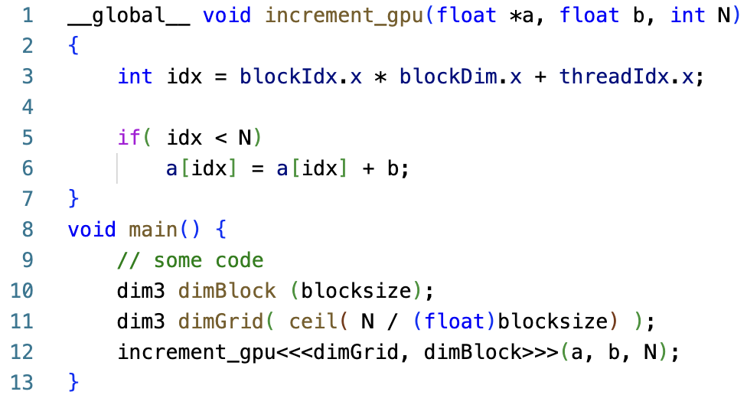
Difference between CPU and GPU Programs
CPU Program
GPU program

Slide 25
Example 1
Task to do
Scan elements of an array of numbers (any of 0 to 9)
Count how many times does “6” appear
The array has 16 elements (SIZE=16)
Each block contains 4 threads (BLOCKSIZE=4)
So each thread checks 4 elements (SIZE/BLOCKSIZE=4)
1 block in the grid
3
6
7
5
3
5
6
2
9
1
2
7
0
9
3
6
threadIdx.x = 0 checks elements 0, 4, 8, 12
threadIdx.x = 1 checks elements 1, 5, 9, 13
threadIdx.x = 2 checks elements 2, 6, 10, 14
threadIdx.x = 3 checks elements 3, 7, 11, 15

Slide 26
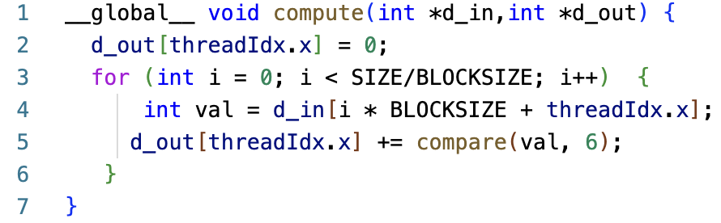
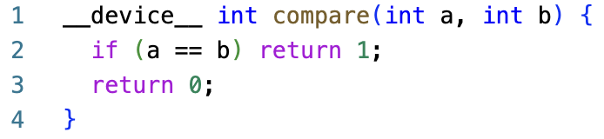
Example 1
Launch Kernel in Host Function:
compute<<<1, 4>>>(d_in, d_out);
Kernel Function:
Thread scans subset of array elements
Call device function to compare with 6
Compute local result
Device Function:
Compare current element and 6
Return 1 if same, else 0
3
6
7
5
3
5
6
2
9
1
2
7
0
9
3
6
threadIdx.x = 0 checks elements 0, 4, 8, 12
threadIdx.x = 1 checks elements 1, 5, 9, 13
threadIdx.x = 2 checks elements 2, 6, 10, 14
threadIdx.x = 3 checks elements 3, 7, 11, 15

Slide 27
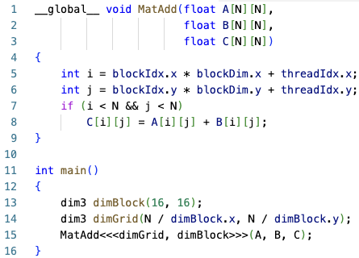
Example 2
Task to do
Element-wise addition of two matrices.
Both matrices have N*N elements.
Each thread does addition for one pair of elements
Each block contains 16*16 threads.
The grid has (N/16) * (N/16) blocks.
blockIdx.x
threadIdx.x
0,0
0,N-1
0,0
0,15
blockIdx.y*blockDim.y
threadIdx.y
blockIdx.y
i,j
threadId.y
blockIdx.x*blockDim.x
threadIdx.x
N-1,0
N-1,N-1
15,0
15,15

Slide 28
GPU Tradeoffs
Very high throughput
Low single thread performance
No complex pipeline
No branch predictor
Your program’s performance depends on the applications’ parallelism
If you can run many things in parallel → very fast
Otherwise → slow

Slide 29
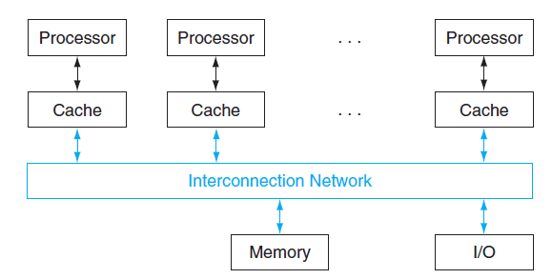
Interconnection
For transferring information between nodes or for broadcasting information to all nodes
Suitability of a network judged by cost, bandwidth, and effective throughput
Bandwidth is capacity in bits per second
Effective throughput is actual rate due to need for transferring control information

Slide 30
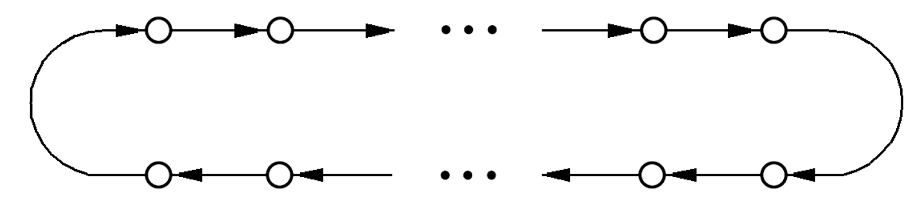
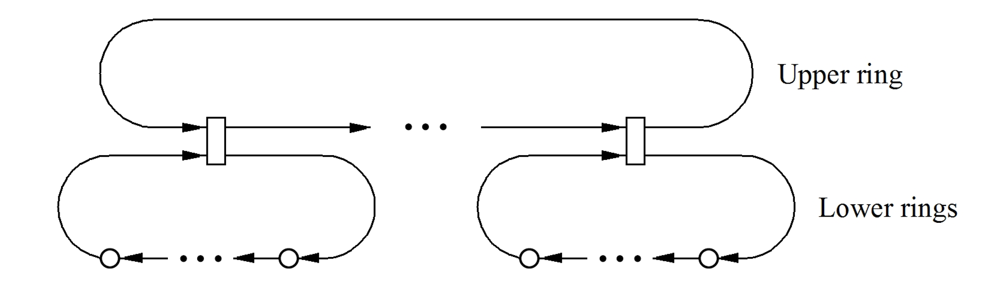
Bus and Ring
A bus is a set of lines providing a shared path
Requires arbitration for one access at a time
Simple bus is held until response is ready, but split-transaction bus can overlap requests
A ring provides point-to-point connections
Bi-directional ring halves average latency
Hierarchy of rings reduces latency for transfers within a lower-level ring or between rings

Slide 31
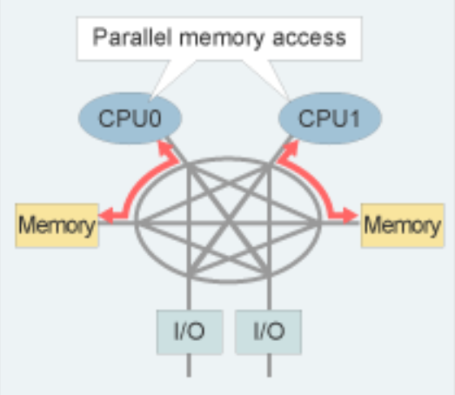
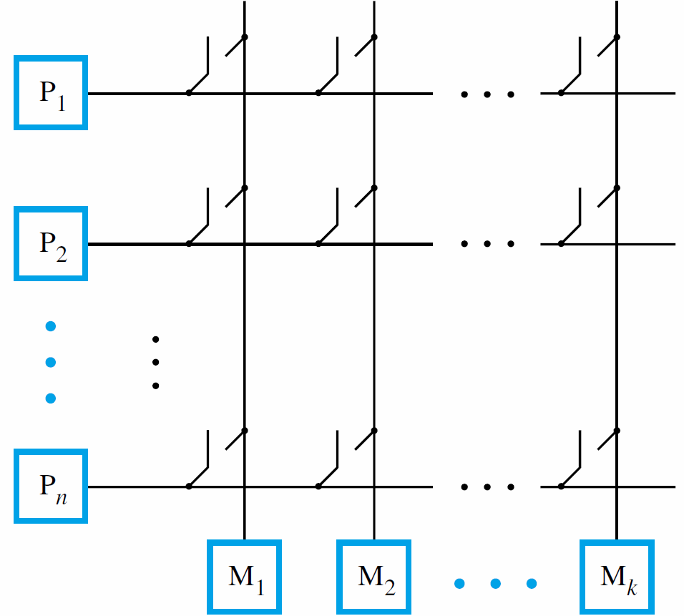
Crossbar
A crossbar provides a direct link between any pair of units connected to the network
Can implement with collection of switches for simultaneous transfers to different destinations

Slide 32
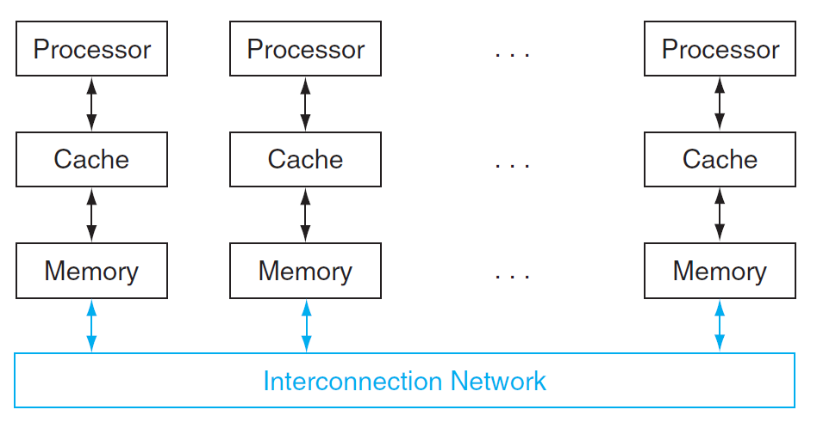
Shared Memory Multiprocessors
All processors have direct (hardware) access to all the main memory, i.e., share the same address space
Multicore processors, GPU, …
Uniform Memory Access (UMA)
Non-Uniform Memory Access (NUMA)

Slide 33
UMA vs NUMA
Uniform Memory Access (UMA) | non-uniform Memory Access (NUMA)
Memory access time is balanced or equal. | Memory access time is not equal.
Single memory controller is used | Multiple memory controllers are used.
UMA is usually slower than NUMA | NUMA is usually faster than UMA
UMA has limited bandwidth | NUMA has higher bandwidth than UMA

Slide 34
Shared Data
Proc 0 writes to an address, followed by Proc 1 reading
Mem[A] is cached (at either end)
Proc 0
Mem[A] = 1
Proc 1
…
Print Mem[A]

Slide 35
Cache Coherence
Basic question: If multiple processors cache the same block, how do they ensure they all see a consistent state?
P1
P2
Interconnection Network
1000
x
Main Memory

Slide 36
Cache Coherence
Basic question: If multiple processors cache the same block, how do they ensure they all see a consistent state?
P1
P2
lw r2, x
1000
Interconnection Network
1000
x
Main Memory

Slide 37
Cache Coherence
Basic question: If multiple processors cache the same block, how do they ensure they all see a consistent state?
lw r2, x
P1
P2
lw r2, x
1000
1000
Interconnection Network
1000
x
Main Memory

Slide 38
Cache Coherence
Basic question: If multiple processors cache the same block, how do they ensure they all see a consistent state?
lw r2, x
add r1, r2, r4
sw r1, x
P1
P2
lw r2, x
2000
1000
Interconnection Network
1000
x
Main Memory

Slide 39
Cache Coherence
Basic question: If multiple processors cache the same block, how do they ensure they all see a consistent state?
lw r2, x
add r1, r2, r4
sw r1, x
P1
P2
lw r2, x
Should NOT load 1000
lw r5, x
2000
1000
Interconnection Network
1000
x
Main Memory

Slide 40
Cache Coherence
Basic idea:
A processor/cache broadcasts its write/update to a memory location to all other processors
Another cache that has the location either updates or invalidates its local copy
P1
P2
2000
1000
Interconnection Network
1000
x
Main Memory

Slide 41
Snoopy Coherence Scheme
All caches “snoop” all other caches’ read/write requests and keep the cache line coherent; invalid the cache line if other caches change the value
Easy to implement if all caches share a common bus
Each cache broadcasts its read/write operations on the bus
Good for small-scale multiprocessors
Full broadcast of all requests is not efficient for large-scale shared-memory multiprocessors

Slide 42
Directory-based Cache Coherence Scheme
Idea: A (logically) central directory keeps track of where the copies of each cache block reside; caches check directory to ensure coherence.
For each memory block, identify which nodes have copies,
If it is modified, request sent to module containing the block for limited broadcast, or to forward to owner

Slide 43
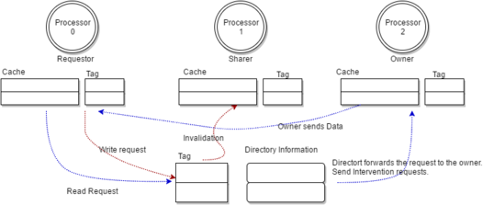
Directory-based Cache Coherence Scheme
Requestor: the processor who requesting for a read/write of a memory block.
Owner: An owner node owns the most recent state of the cache block, note that directory might not be always up to date with latest data.
Sharer: One or many node which are sharing a copy of the cache block.

Slide 44
Snoopy vs Directory-Based
Snoopy | Directory-based
Full broadcast communication | Limited broadcast or point-to-point communication
Simple control logic | More complex control logic (need to maintain directory states)
Low latency | Higher latency (need to access the directory)
Limited scalability | Good scalability

Slide 45
Message-Passing Multiprocessors
Processors have their own physical address space
memory accessed only by local processor
Communicate via explicit message passing
one processor needs to know when a message is sent, and the receiving processor needs to know when a message arrives

Slide 46
Message-Passing Multiprocessors
Each node is effectively a complete computer
To build large-scale computers, usually use high-performance message-passing interconnection networks
Special interconnection networks offer better communication performance than using e.g., LAN, but is much more expensive
Much easier for hardware designer to build
But require more programming efforts

Slide 47
Shared Memory vs Message Passing
Shared Memory | Message Passing
The shared memory region is used for communication. | A message passing facility is used for communication.
Communicating processes share a common address space. | Communicating processes have different address space.
It provides a maximum speed of computation as communication is done through shared memory so system calls are made only to establish the shared memory. | It is time-consuming as message passing is implemented crossing software layers (e.g., system calls provided by operating systems).
Faster communication strategy. | Relatively slower communication strategy.
It can be used in exchanging larger amounts of data. | It can be used in exchanging small amounts of data.
Software on different processors need to ensure the data consistency | Explicit communication actions, no consistency problem

Slide 48
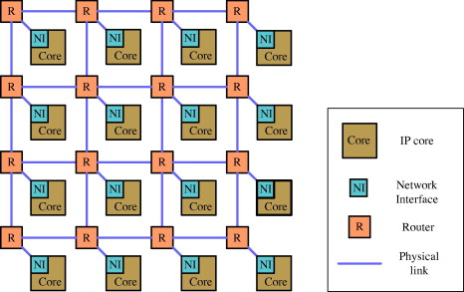
Network-on-Chips (NoC)
Bus has been the most popular for multiprocessor systems, but
When expanding to a many core-system, contention decreases throughput;
When scaling sizes and frequency, wire delays remain larger than clock cycle
Need for interconnect with deterministic delays and scalability
Network-on-Chip (NoC): Each on-chip component connected by an intelligent switch (router) to particular communication wire(s)
Leveraging existing computer networking principles for on-chip communications

Slide 49
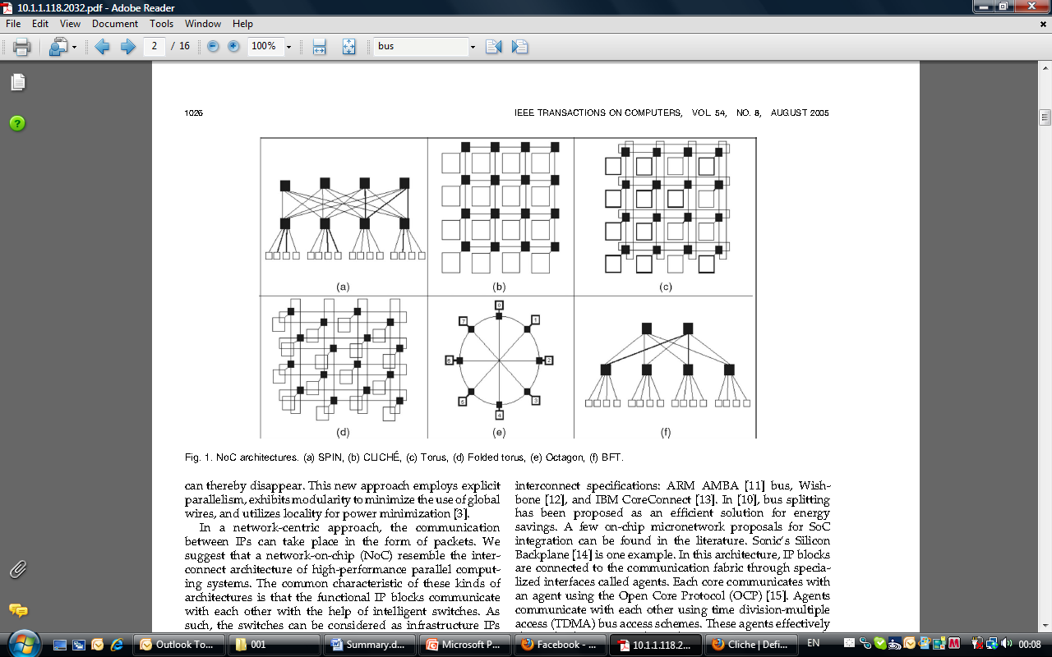
Network-on-Chips (NoC)
Mesh NoC

Slide 50
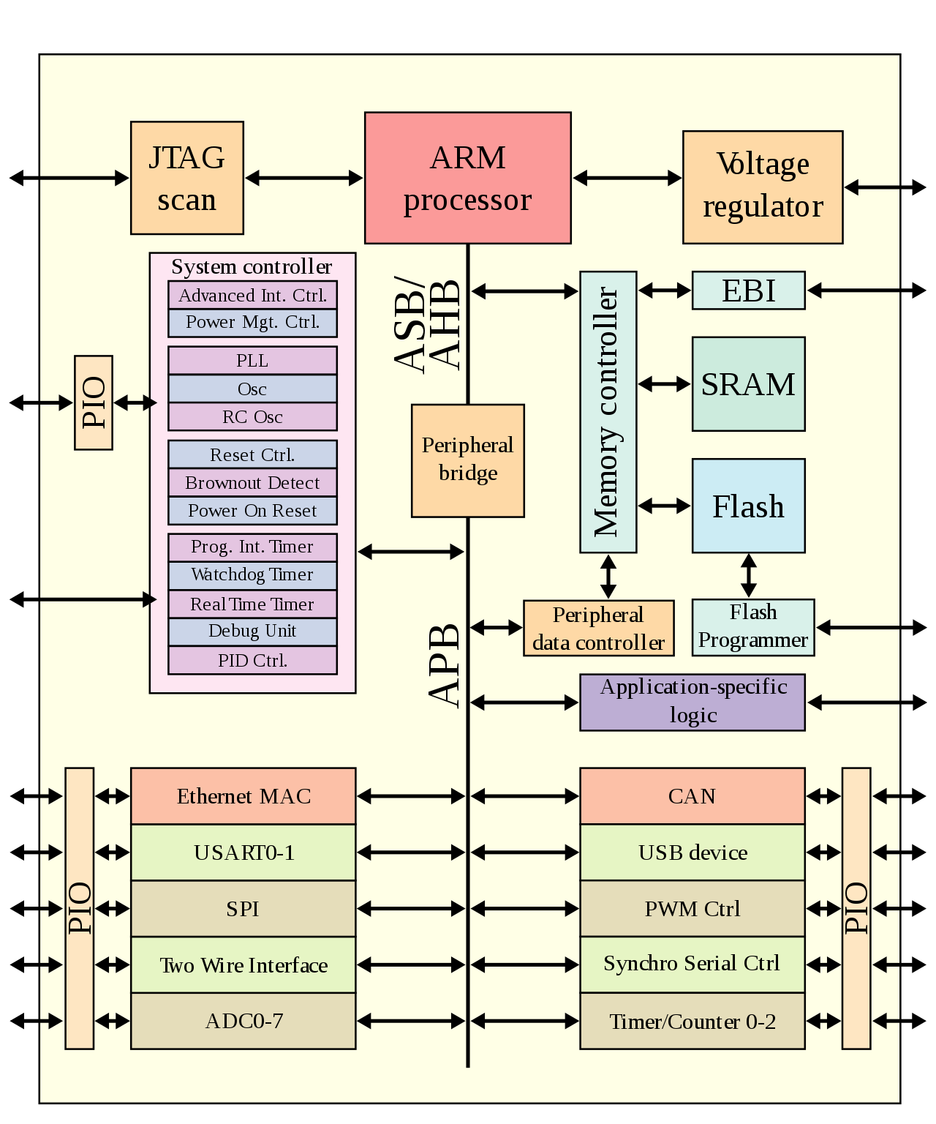
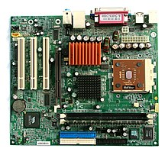
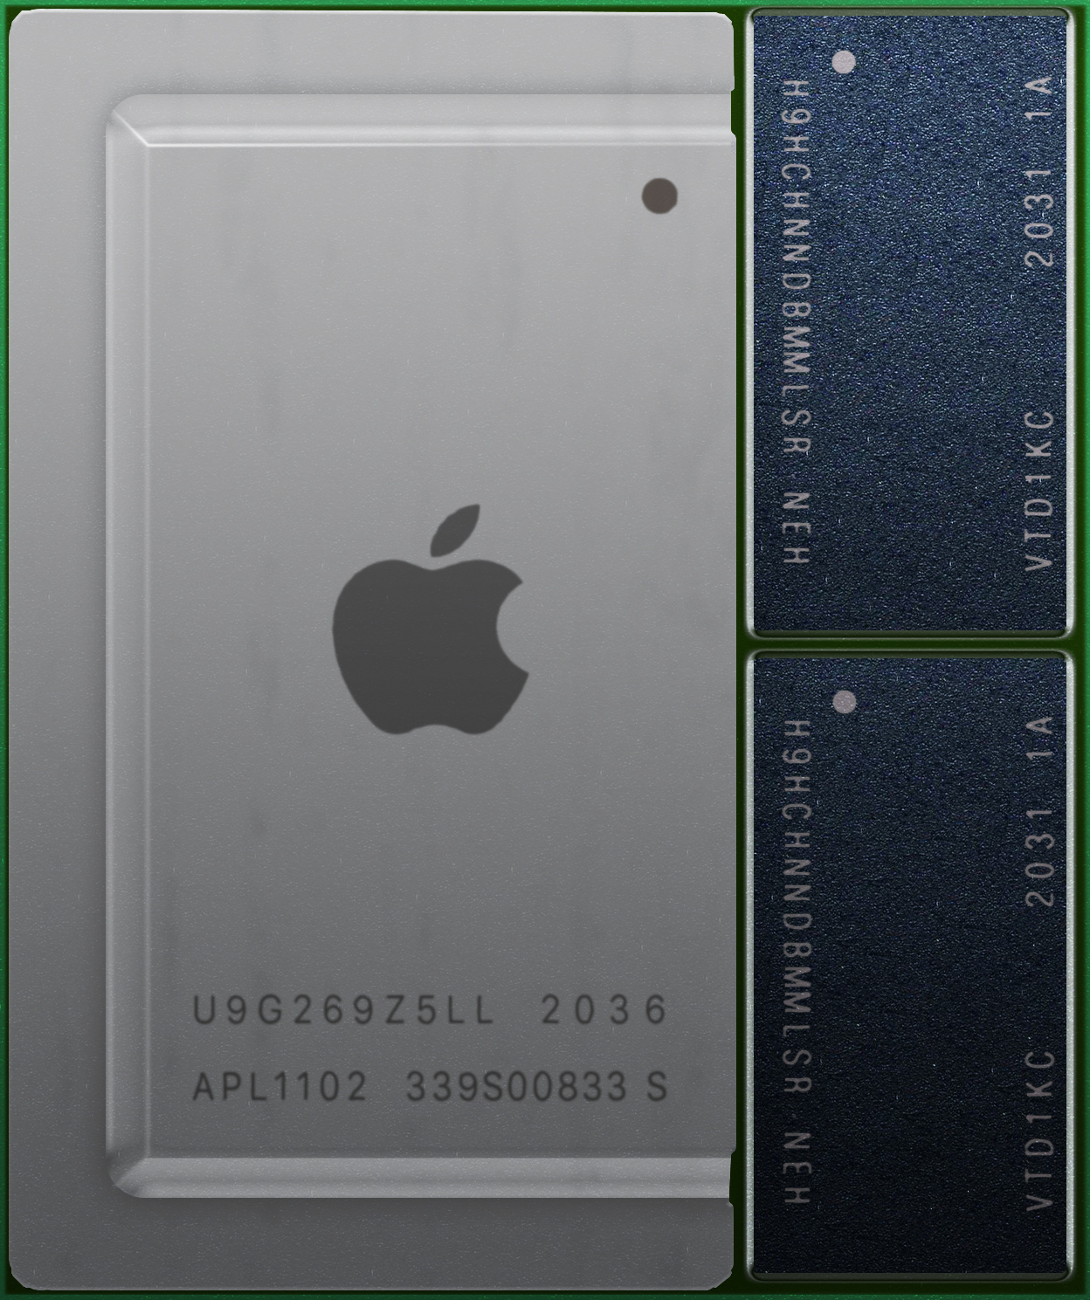
System-on-Chip (SoC)
Integrates most or all components of a computer on one chip
Rather than many chips on a board
Popular in domains sensitive to size and energy efficiency
Mobile devices
Embedded devices

